Slide 1
File One
Go to link: https://www2.jpx.co.jp/tseHpFront/JJK020010Action.do?Show=Show
Select the following filters:
Number of displayed companies: 200
Market Segment: [x]Prime
Click Search. Should display 1-200 items/1835 (10 pages).
In one Excel sheet scrape each of the Columns for each row on the 10 pages (note: ignore the ‘Basic Information’ and ‘Stock Prices’ button values).

Slide 2
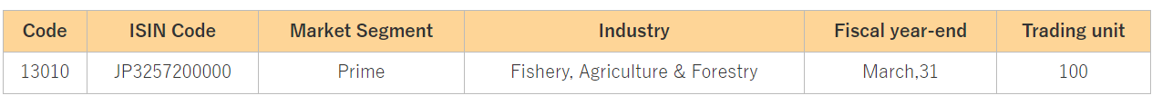
File two
From the same search (with the 1835 results). Enter the ‘Issue Name’ value for each Company into Column A of Excel file. Then click ‘Basic Information’ for each individual row. On this page enter each of the following columns into the Excel table and input the values into the correct row (which has the Column A value of the button click). Enter the information from each unique Issue Name’s ‘Basic Information’ page. There should be 1835 rows in this file with 7 Columns.

